Slide 1


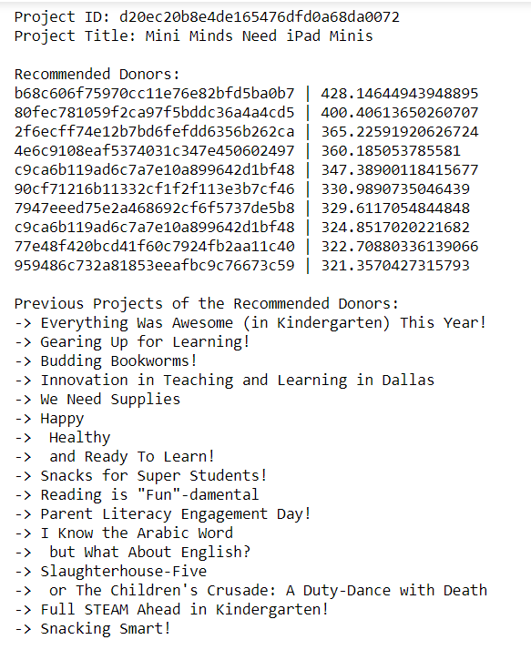
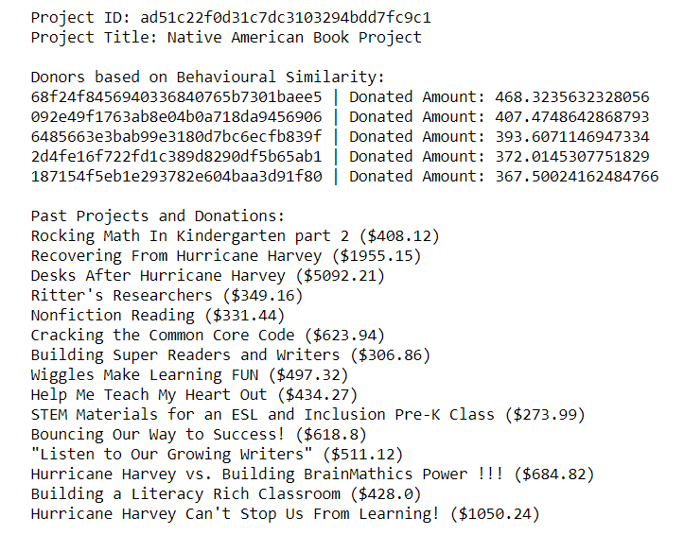
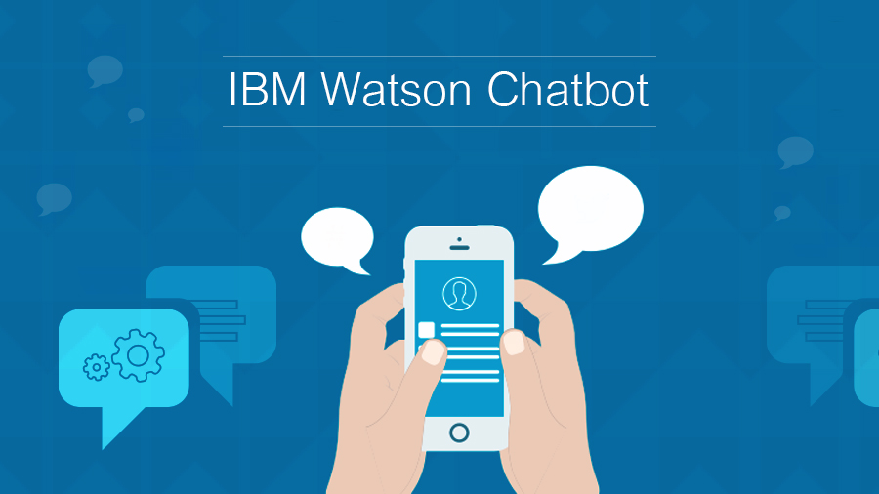
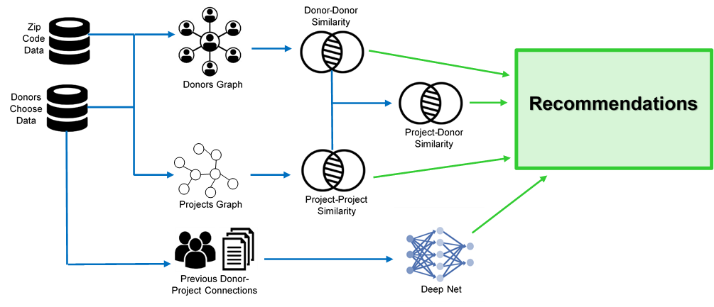
DonorsChoose.org Recommender System
Team Members:
Abhitej Kodali
Caitlyn Garger
Yina Dong
Business Intelligence & Analytics
Introduction
DonorsChoose.org has been able to fund over 1 million projects with the help of about 3 million donors
Teachers are still spending over a billion dollars of their own money
It is our goal build an accurate recommender system that will connect donors to projects that motivate and inspire them.
With implementation of our recommender system, more efficient and effective connections with donors will be made.
Recommendation System
Data
Dataset taken from past Kaggle competition: https://www.kaggle.com/donorschoose/io/home
Includes information about donations, donors, resources, schools, and teachers.
Over 900,000 unique projects
Over 4 million unique donations
Over 2 million unique donors
Example of recommended donors and their past donations/projects
Conclusion
With implementation of a successful recommender system you will see higher retention of donors, increased frequency/amount of donations, and improved engagement and satisfaction of those involved.
When a donor is matched with causes/projects that are close to their heart, they are more likely to donate higher amounts and more often and maybe even spread the word to family and friends so they can share in the satisfaction of helping the less fortunate.
Model/Approach
Ensemble of a graph-based approach and a deep neural network
Project and donor profiles based on past data + additional features created using: aggregations, feature engineering, word embedding vectors → similarity graph
Past project donor interactions in the form of matrix where every cell value represents the interaction score → trained Deep Net will try and predict interaction score
Future Work
Website or app similar to Kickstarter where donors can see the current progress of projects they have donated to and get recommendations for other projects
Make these services available to teachers as well to guide them in their campaign creations (how similar projects to theirs performed, who funded them, etc.)
Integrating our recommender system with a chatbot so donors can have the most personal and custom experience
http://www.stevens.edu/school-business/masters-programs/business-intelligence-analytics

